Slide 1

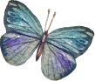
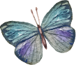
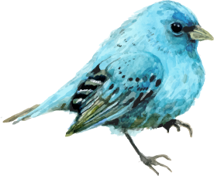
Natural Science Thesis
Here is where your presentation begins

Slide 2
Contents of this template
You can delete this slide when you’re done editing the presentation
Fonts | To view this template correctly in PowerPoint, download and install the fonts we used
Used and alternative resources | An assortment of graphic resources that are suitable for use in this presentation
Thanks slide | You must keep it so that proper credits for our design are given
Colors | All the colors used in this presentation
Icons and infographic resources | These can be used in the template, and their size and color can be edited
Editable presentation theme | You can edit the master slides easily. For more info, click here
For more info: SLIDESGO | BLOG | FAQs
You can visit our sister projects: FREEPIK | FLATICON | STORYSET | WEPIK | VIDEVO

Slide 3
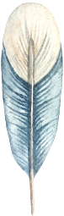
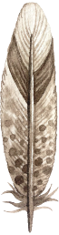
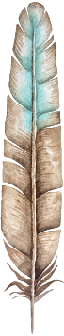
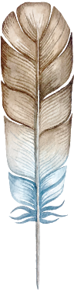
Table of contents
01
02
03
04
Section 01
Section 02
You can add a subtitle here if you need it
You can add a subtitle here if you need it
Section 03
Section 04
You can add a subtitle here if you need it
You can add a subtitle here if you need it

Slide 4
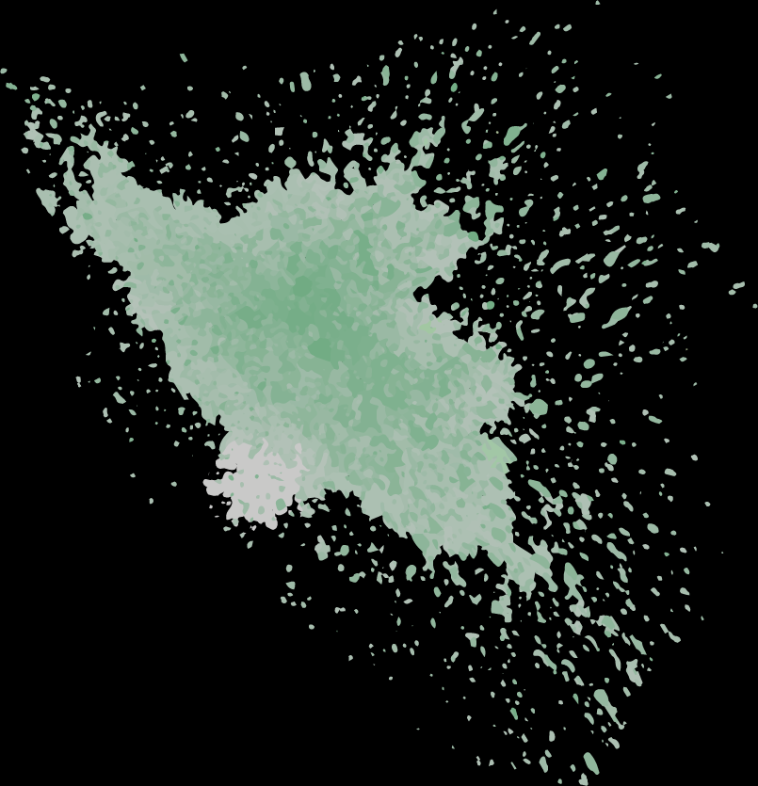
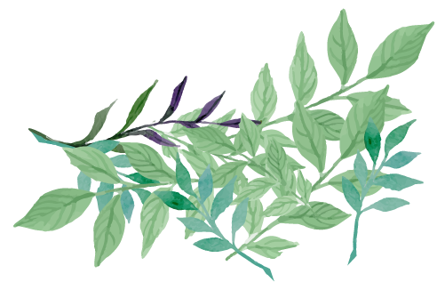
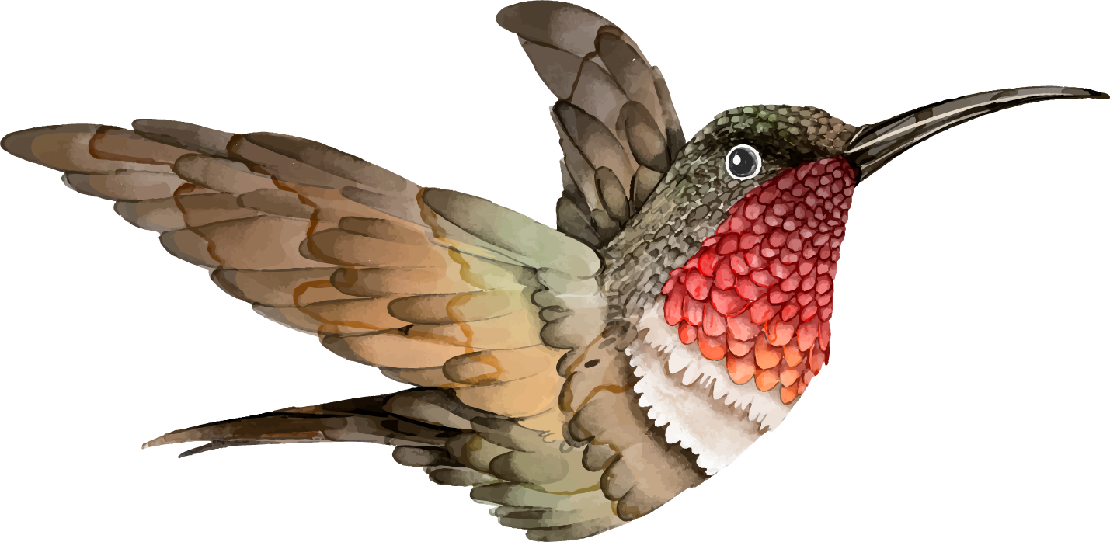
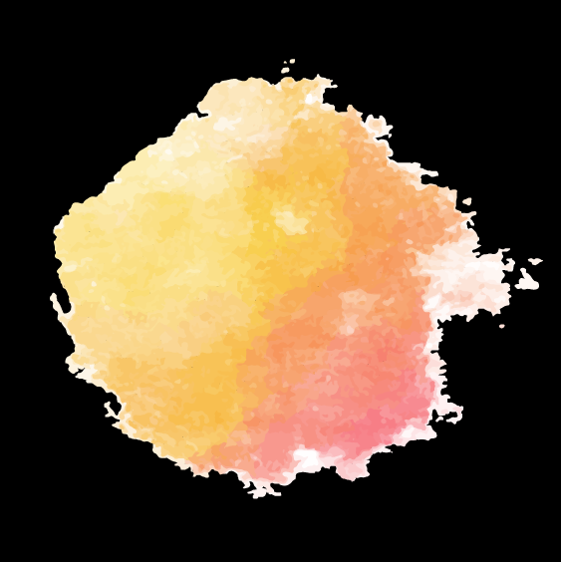

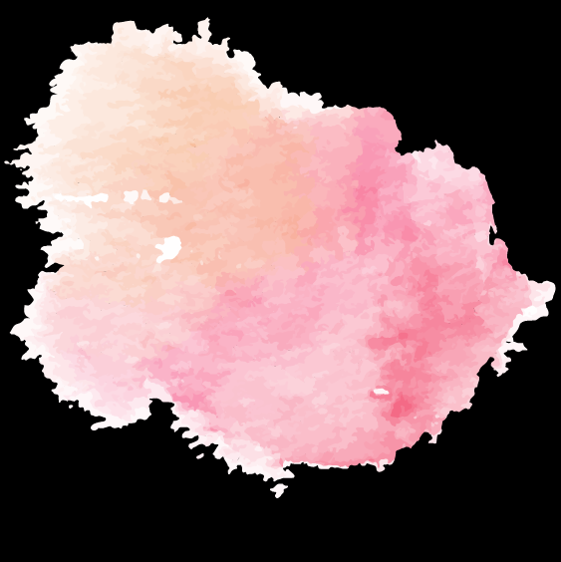
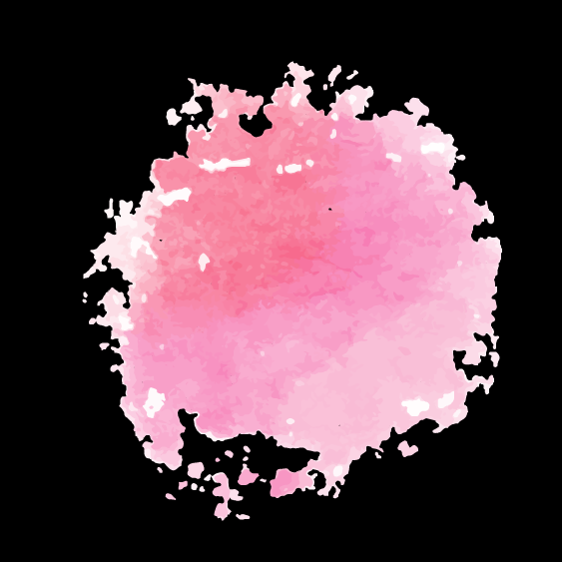

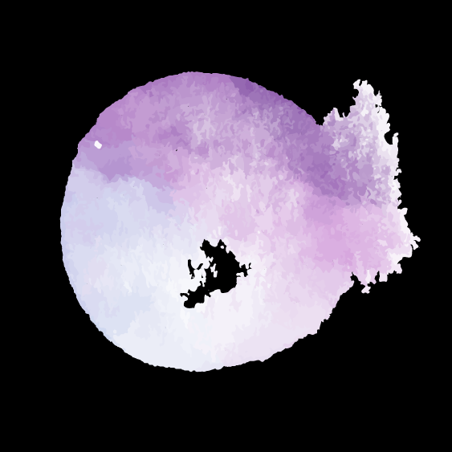
Objectives
Mercury
Mars
Jupiter
It’s the closest planet to the Sun
Despite being red, it’s a cold place
It’s the biggest planet in the Solar System
Venus
Saturn
Neptune
Venus is the second planet from the Sun
It’s composed of hydrogen and helium
It’s the farthest planet from the Sun

Slide 5
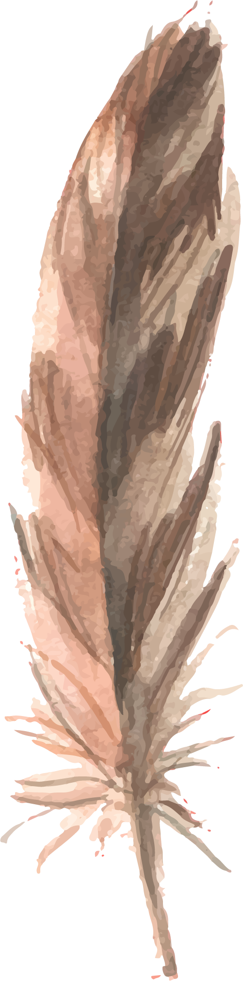
A picture always reinforces the concept
Do you know what helps you make your point clear? Lists like this one:
They’re simple
You can organize your ideas clearly
You’ll never forget to buy milk!
The audience won’t miss the point of your presentation

Slide 6

Introduction
Mercury is the closest planet to the Sun and the smallest one in the Solar System—it’s only a bit larger than the Moon

Slide 7
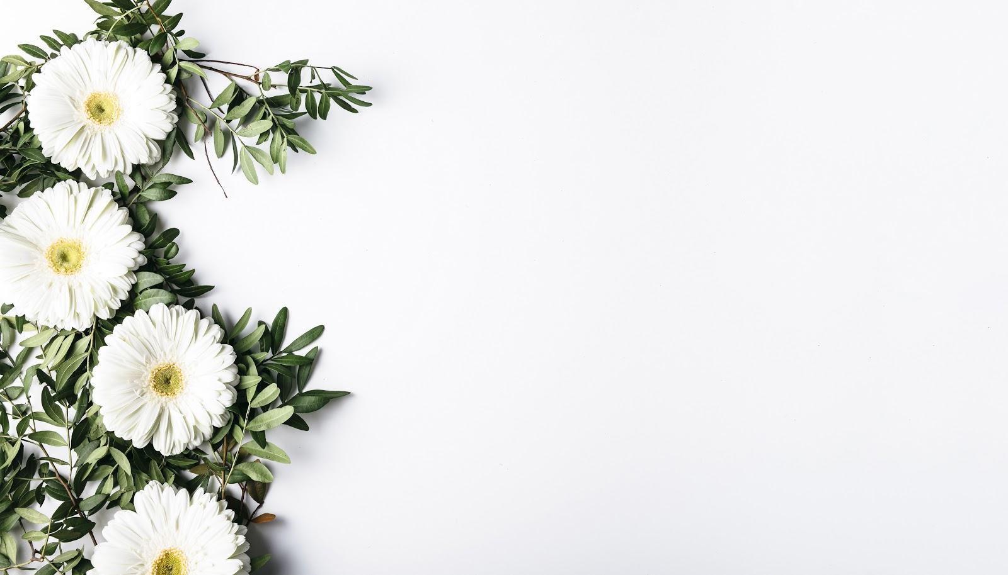
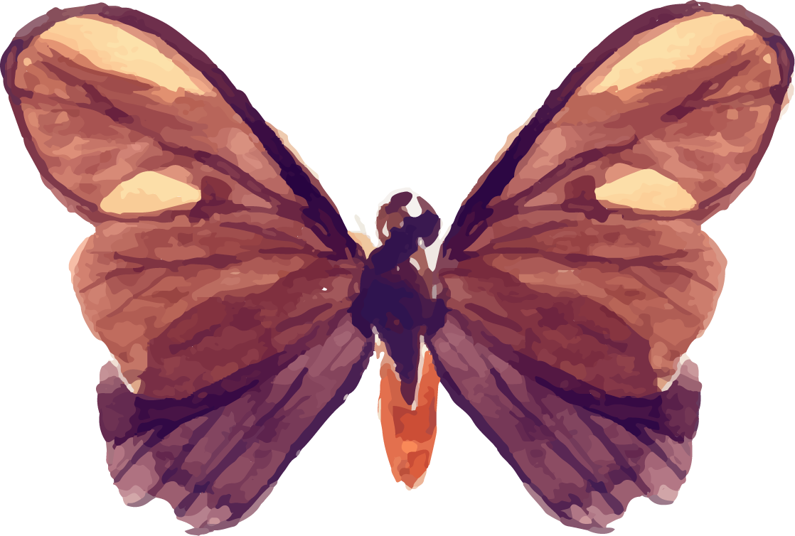
A picture is worth a thousand words

Slide 8
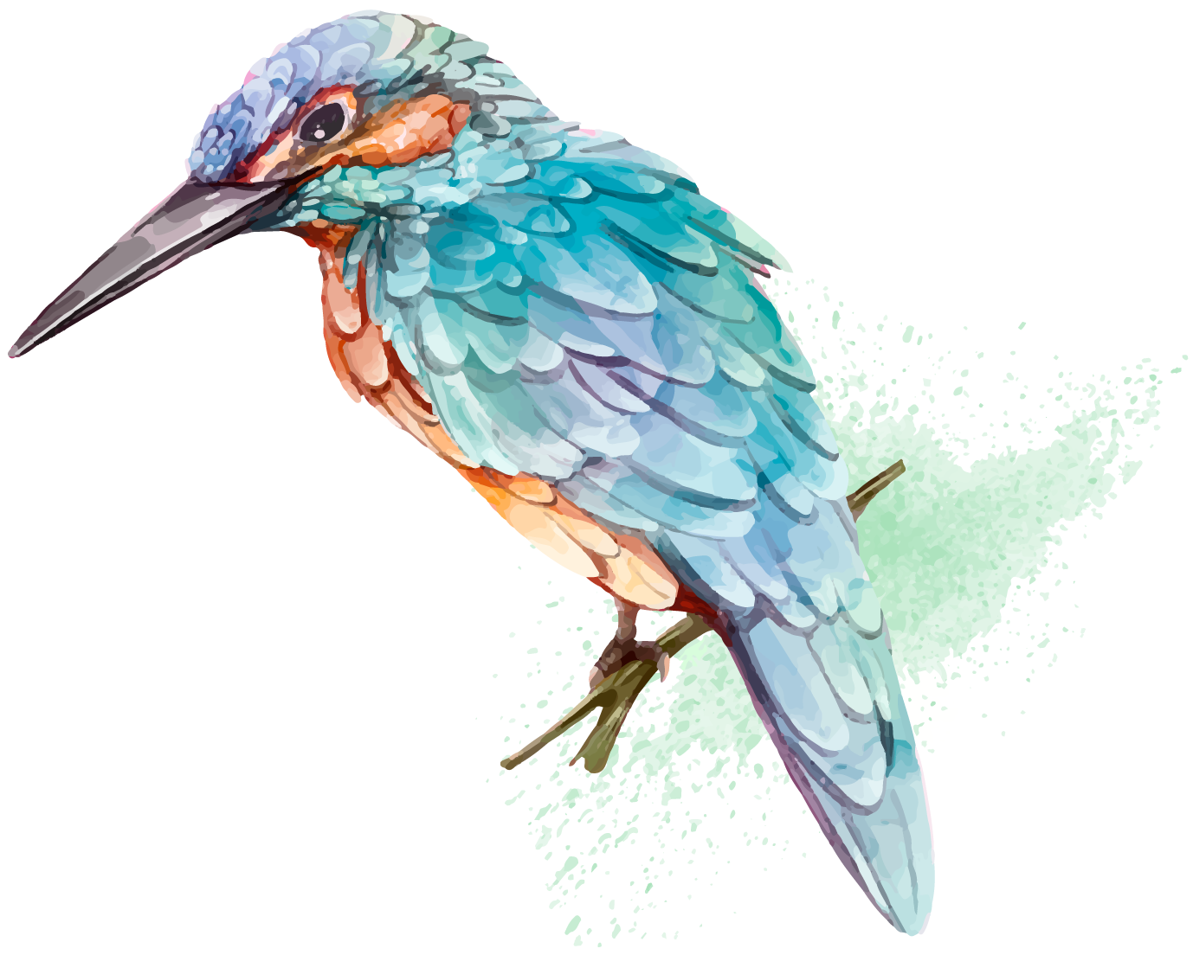
“This is a quote, words full of wisdom that someone important said and can make the reader get inspired.”
—Someone Famous

Slide 9
You can also use 4 columns
Mercury
Mars
Mercury is the closest planet to the Sun
Despite being red, Mars is actually a cold place
Saturn
Neptune
Saturn is composed of hydrogen and helium
Neptune is the farthest planet from the Sun

Slide 10
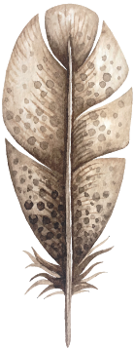



Literature review
Mercury
Mars
Jupiter
It’s the closest planet to the sun
Despite being red, it’s a cold place
It’s the biggest planet of them all

Slide 11

Schedule
Week 01 | 29 | 30 | 1 | 2 | 3 | 4 | 5
Week 02 | 6 | 7 | 8 | 9 | 10 | 11 | 12
Week 03 | 13 | 14 | 15 | 16 | 17 | 18 | 19
Week 04 | 20 | 21 | 22 | 23 | 24 | 25 | 26
Week 05 | 27 | 28 | 29 | 30 | 31 | 1 | 2

Slide 12
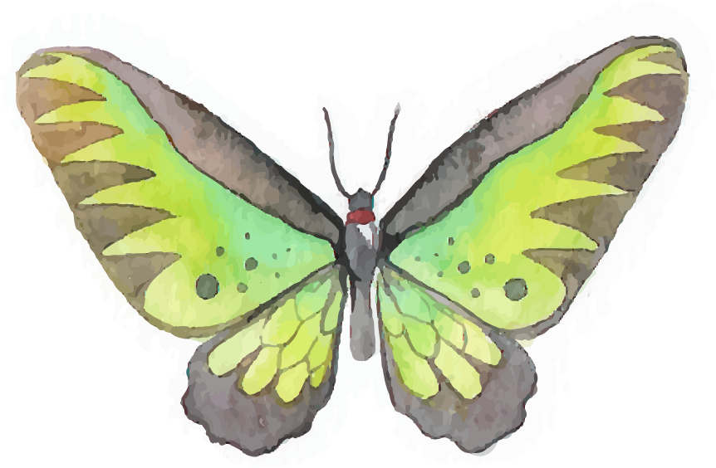


01
Name of the section
Here you can enter a subtitle if you need it

Slide 13


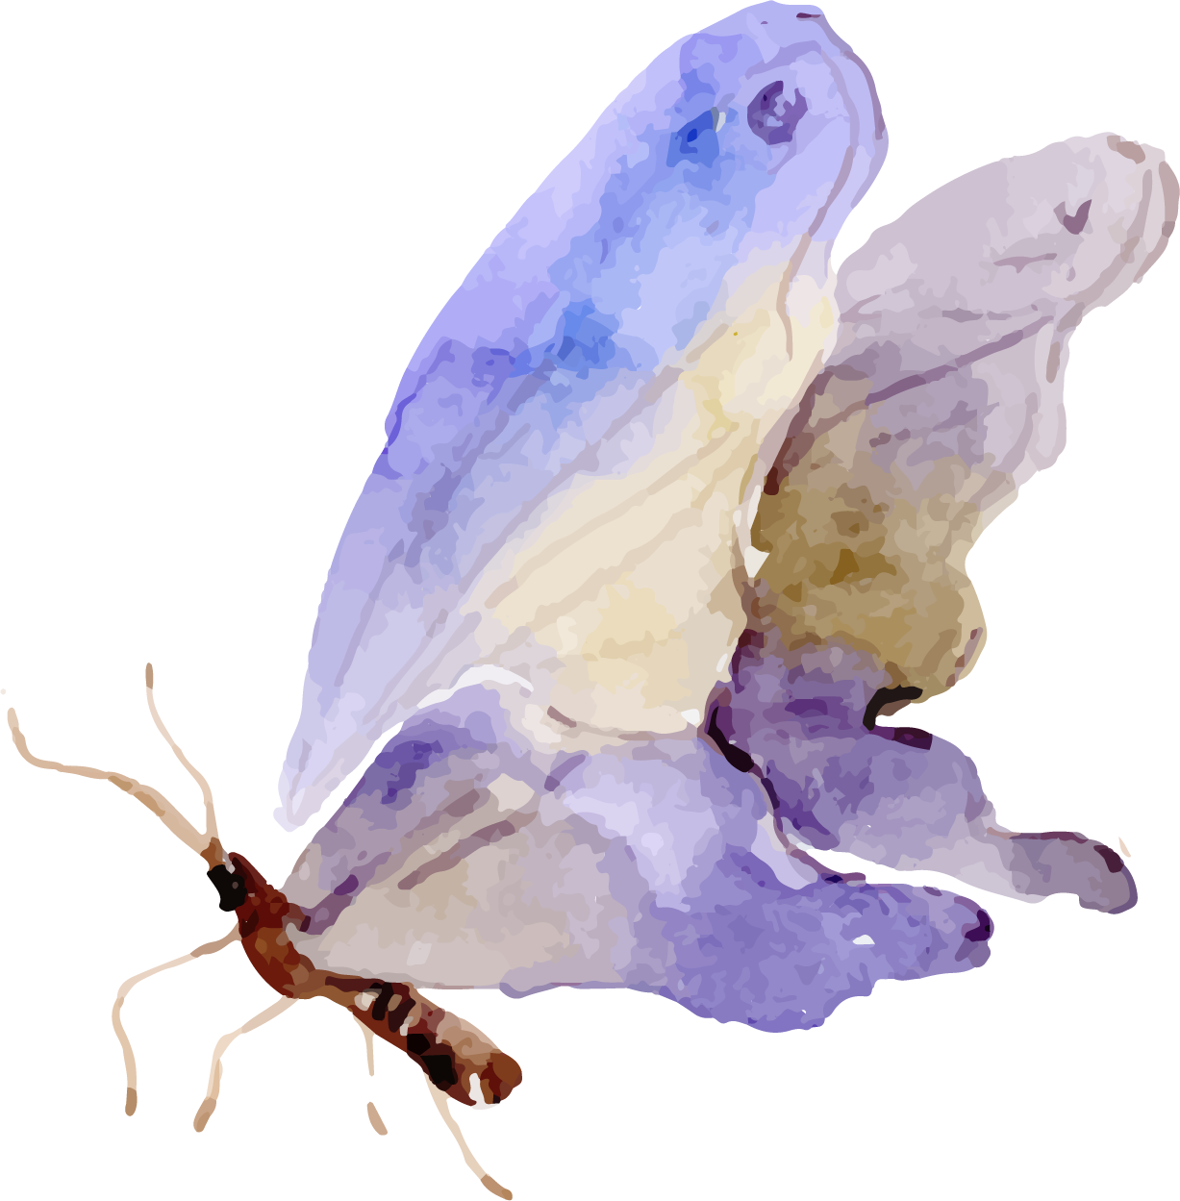

Methodology
Step 01
Step 02
Step 03
Step 04
Jupiter is the biggest planet of them all
Despite being red, Mars is a cold place
Mercury is the smallest planet of them all
Venus has a beautiful name, but it’s hot

Slide 14
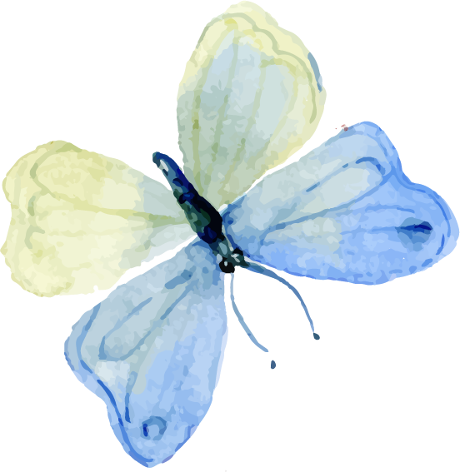
Results analysis
50%
50M
12K
Mercury
Mars
Jupiter
Mercury is the closest planet to the Sun
Despite being red, Mars is a cold place
It’s the biggest planet in the Solar System

Slide 15
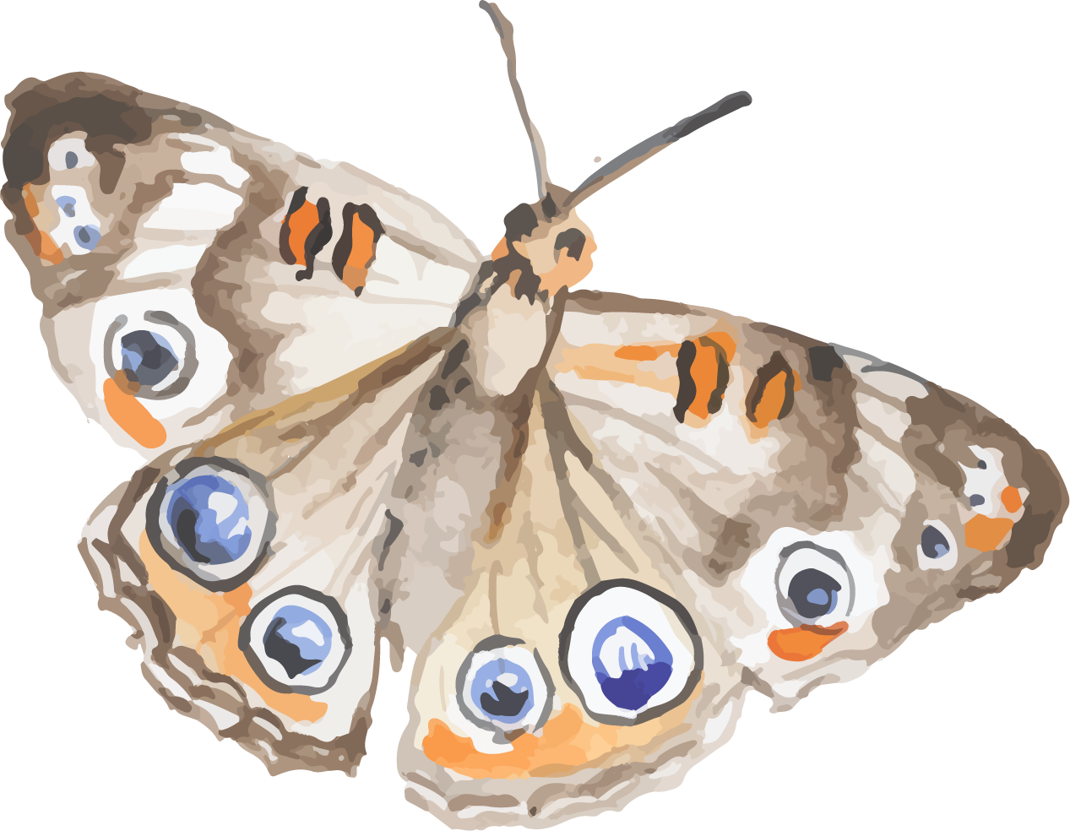
Awesome words
Because key words are great for catching your audience’s attention

Slide 16
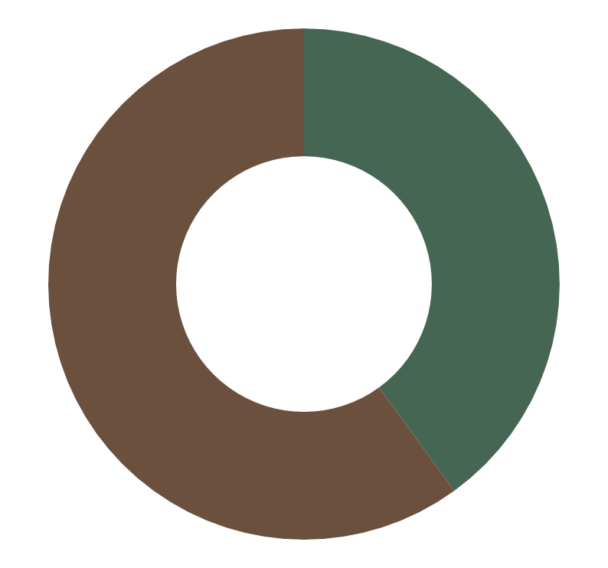
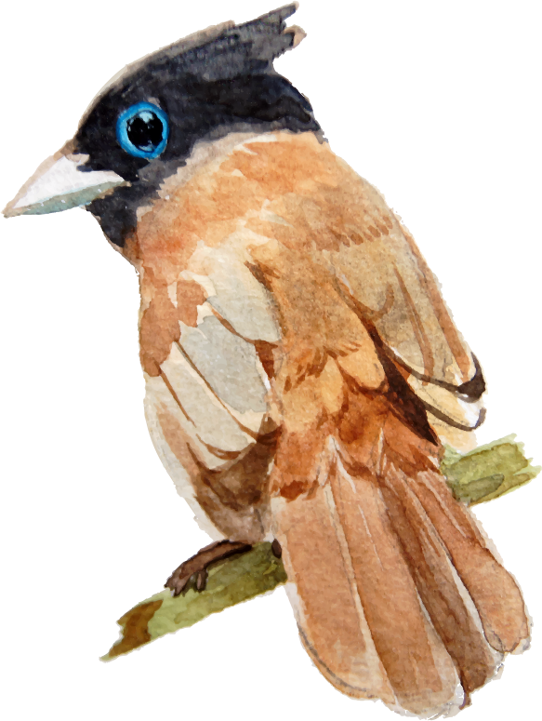
Results analysis
Mercury
Mercury is the closest planet to the Sun
Jupiter
It’s the biggest planet in the Solar System
*To modify this graph, click on it, follow the link, change the data and replace it

Slide 17
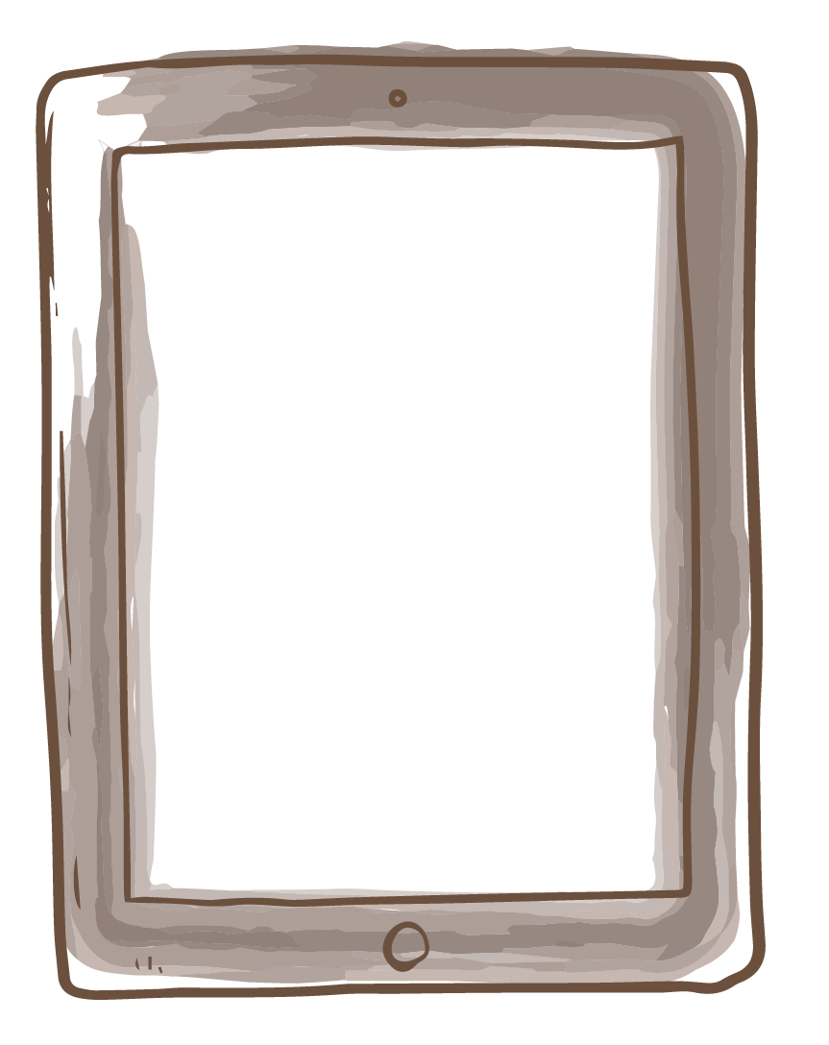
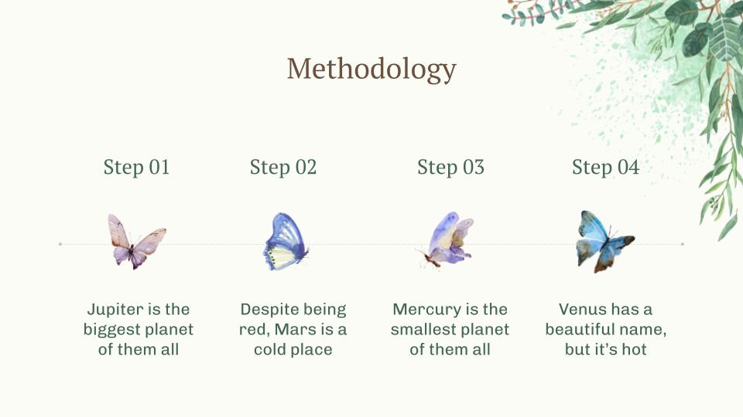
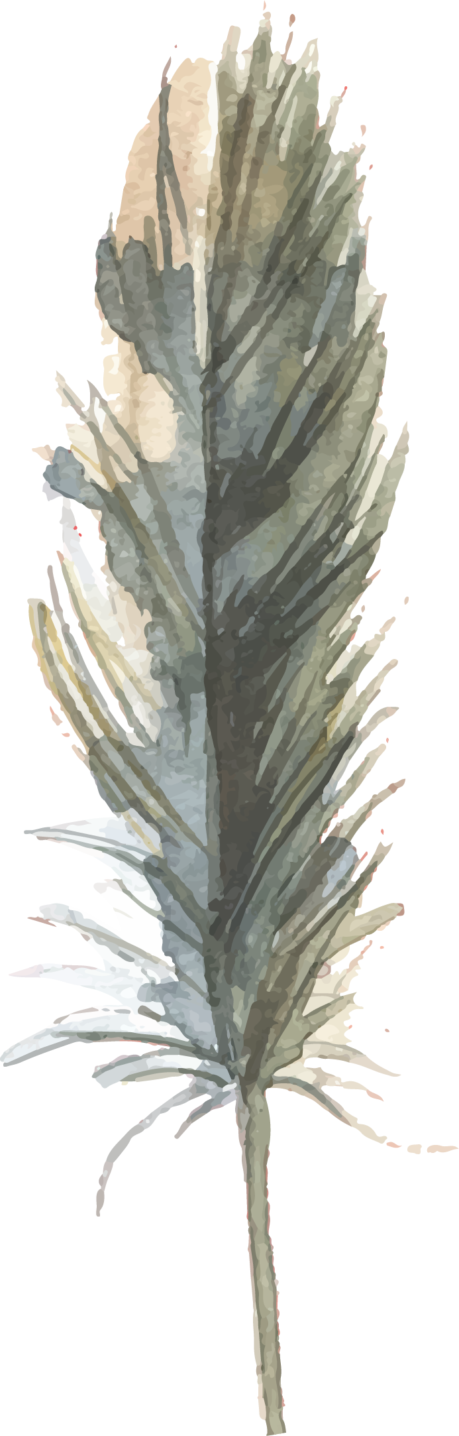
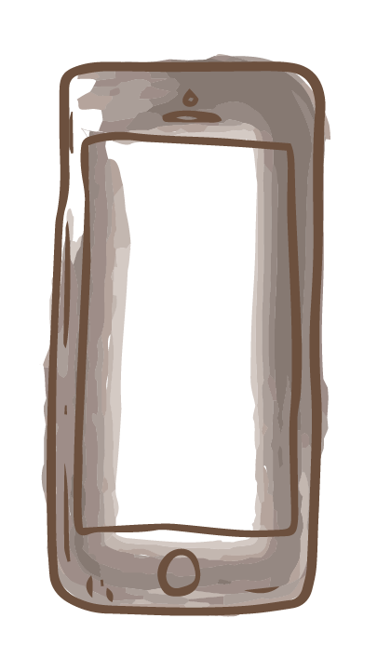
Sneak peek
You can replace the image on the screen with your own work. Just delete this one, add yours and center it properly

Slide 18
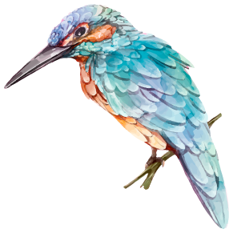
This is a hummingbird
Mercury is the closest planet to the Sun
Despite being red, Mars is actually a cold place
Venus has a beautiful name, but it’s hot

Slide 19
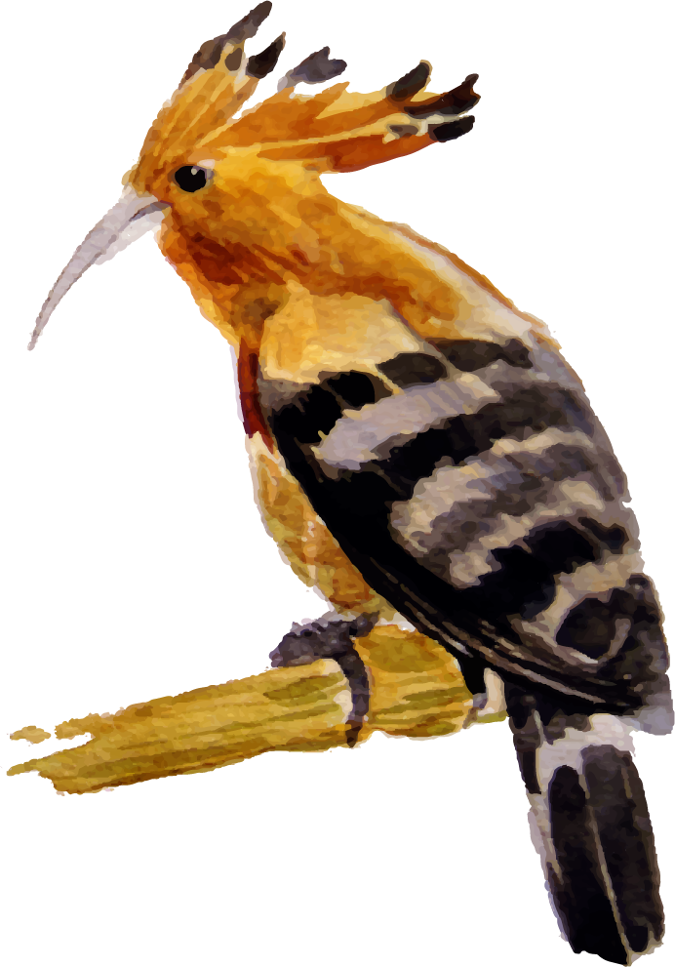
You can show data in a table
/ | Test 01 | Test 02 | Test 03 | Test 04 | Test 05
Metrics 01 | 100 | 350 | 430 | 120 | 100
Metrics 02 | 212 | 430 | 321 | 540 | 560
Metrics 03 | 250 | 120 | 902 | 694 | 504
Metrics 04 | 320 | 465 | 785 | 895 | 737

Slide 20
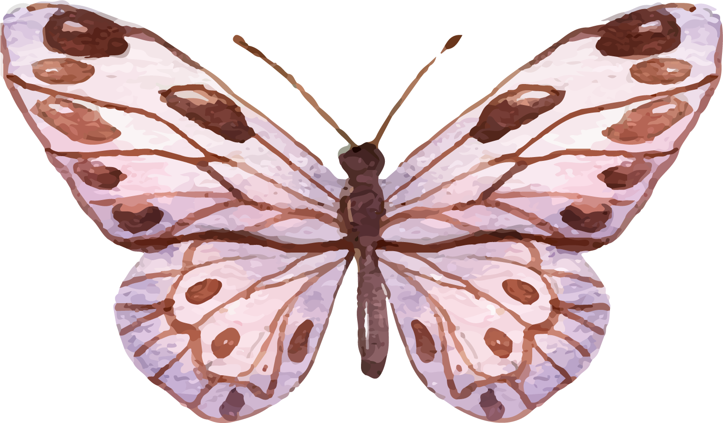
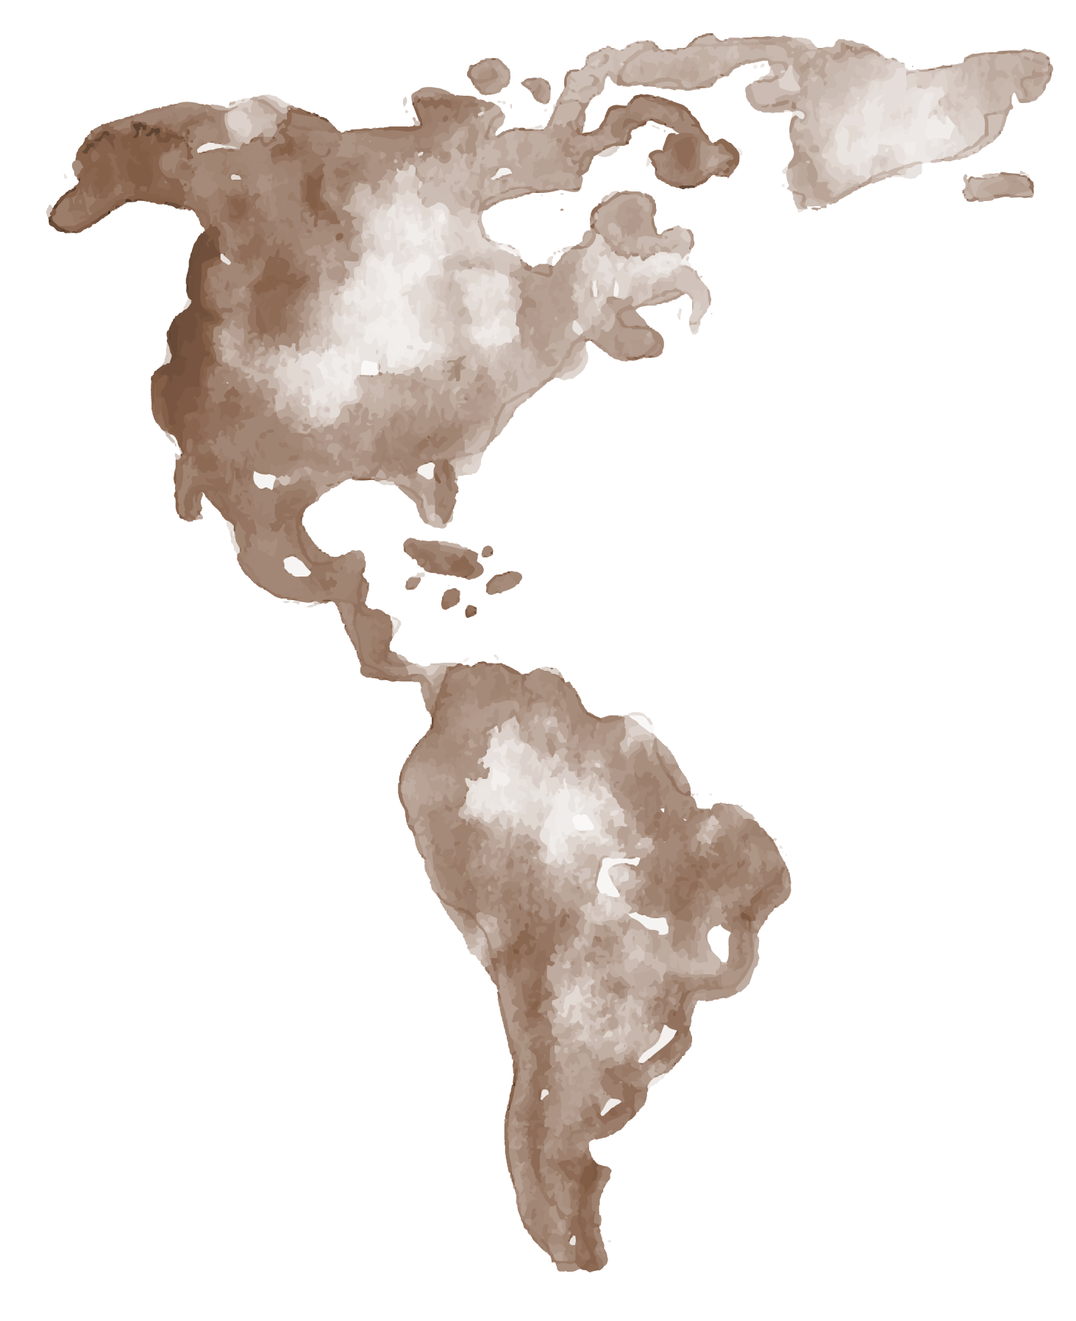
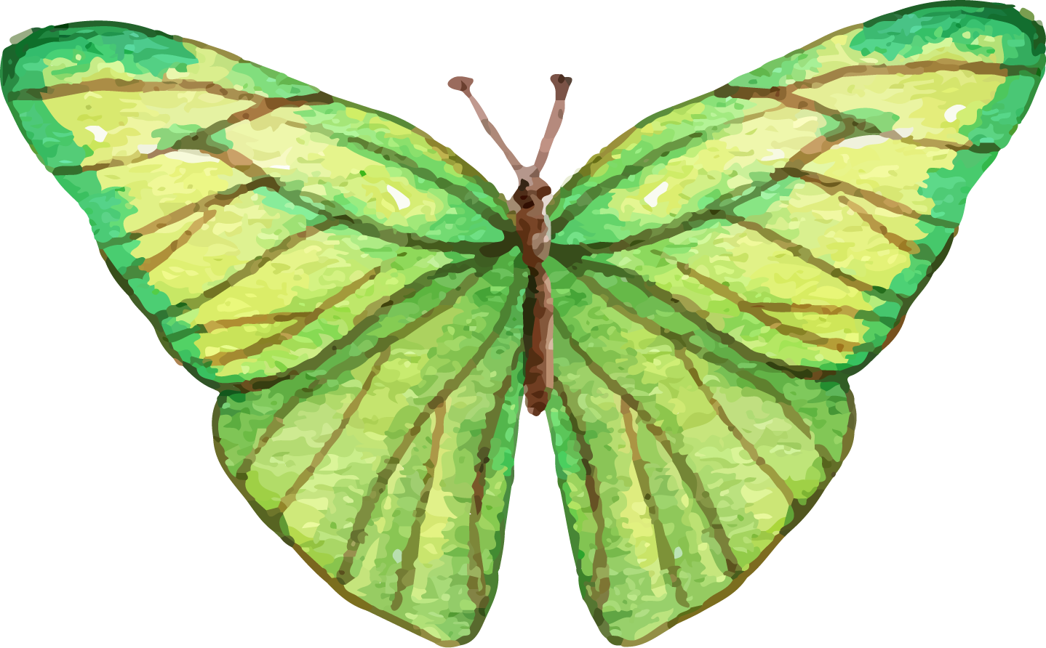

This is a map
Venus has a beautiful name, but it’s quite hot
Despite being red, Mars is actually a cold place
Jupiter is the biggest planet of them all

Slide 21
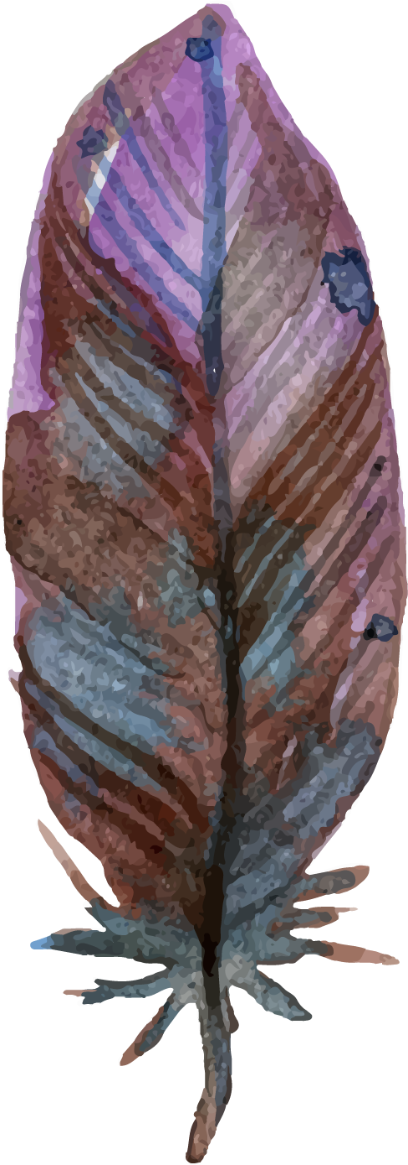
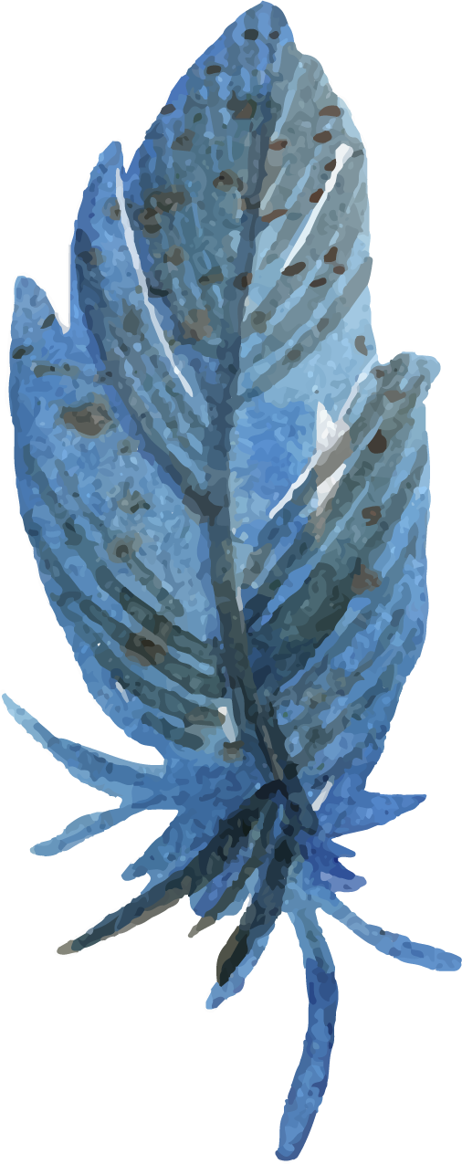
Conclusions
Mars
Venus
Despite being red, Mars is actually a cold place. It’s full of iron oxide dust, which gives the planet its reddish cast
Venus has a beautiful name and is the second planet from the Sun. It’s terribly hot, even hotter than Mercury

Slide 22

Bibliographical references
Author (Year). Title of publication. Publisher
Author (Year). Title of publication. Publisher
Author (Year). Title of publication. Publisher
Author (Year). Title of publication. Publisher
Author (Year). Title of publication. Publisher
Author (Year). Title of publication. Publisher
Author (Year). Title of publication. Publisher
Author (Year). Title of publication. Publisher

Slide 23
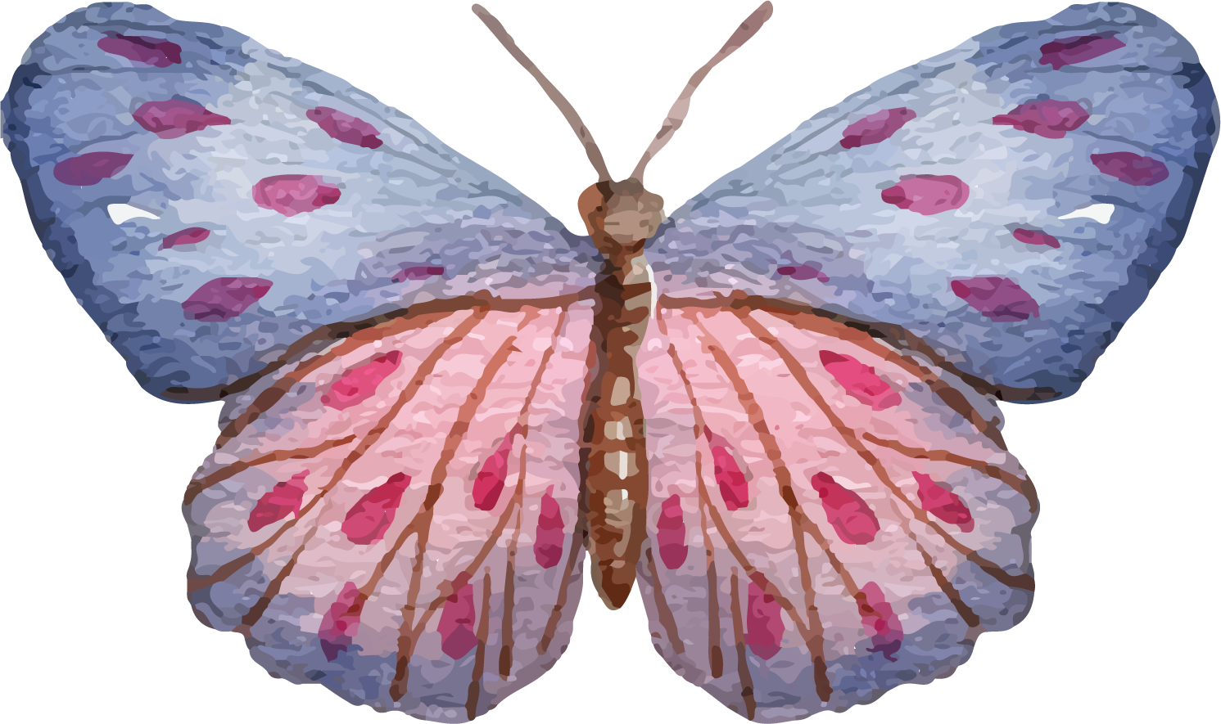
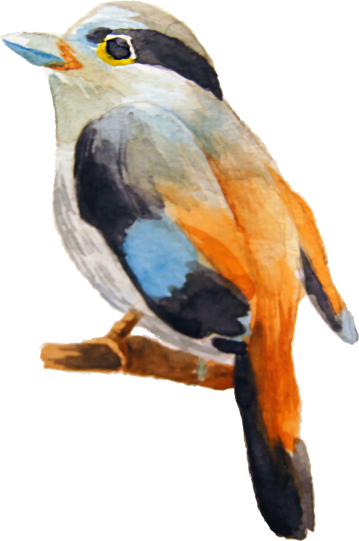
Thanks!
Do you have any questions?
youremail@freepik.com
+34 123 456 789
yourcompany.com
Please keep this slide for attribution

